Slide 1
Introduction to Neural Networks

Slide 2

Machine Learning
Computer Program
Output (Class Label)
Keep an expert in the loop to design the algorithms(Rules)
What if Expert has no idea to design the rule?
What if Rules are complex and has exceptions and special cases?

Slide 3
Machine Learning
Program to extract rules
Implement Rules
Output (Class Label)
Class Label

Slide 4
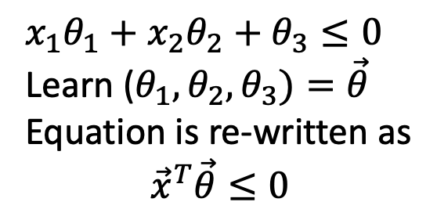
Machine Learning
Program to extract rules
Implement Rules
If below the line then
else :
Output (Class Label)
$x_{1}θ_{1}+$ $x_{2}θ_{2}+θ_{3}≤0$
Learn ($θ_{1},θ_{2},θ_{3})=\vec{θ}$
Equation is re-written as
$${\vec{x}}^{T}\vec{θ}≤0$$
Class Label

Slide 5
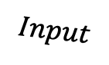
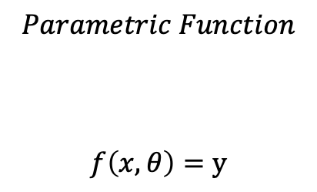
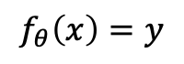

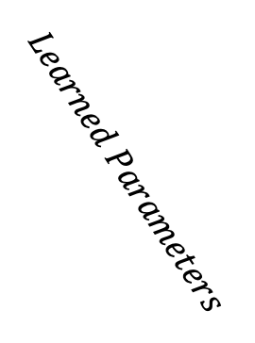
Machine Learning (in general..)
If below the line then
else :
$$Parametric Function$$
$$f\left(x,θ\right)=y$$
$$f_{θ}\left(x\right)=y$$
$$output$$
$$Input$$
$$Learned Parameters$$

Slide 6
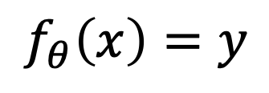
Shallow Learning
Computer Program
$$f_{θ}\left(x\right)=y$$
Output (Class Label)

Slide 7
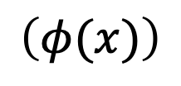
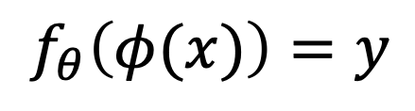
Shallow Learning
Fixed Algorithm to extract the features
$$\left(φ(x)\right)$$
$$f_{θ}\left(φ(x)\right)=y$$
Output (Class Label)

